Slide 1


Project name: Netflix Data Analysis
By
Kanchan Shivdas Gode
Batch 2022-8414
Enrollment number : EBEON1122694895

Slide 2
Outline:
Creating a better and user friendly environment for Netflix users by analyzing its dataset in order to decrease redundancy based on viewers choice.

Slide 3
Project Background:
Netflix is a entertainment streaming platform.
Search option for streaming TV shows and Movies and latest updates of Netflix Home.
Top Picks: Higher runtime, latest action / Drama shows or Movies.
Personalize recommendation of data.
Advance Data analysis.

Slide 4
Motivation:
User is spending more time and streuggling to search their favourites.
Time vs User Experience
History of user defines what type of content they wants.
Some of the movies are not popping out exactly.
Multiple users accessing at the same time.

Slide 5
Problem Statement:
The goal of my project is for analyze Netflix data that will be able to facilitate a wider range viewers by decreasing redundancy using NumPy datasets concepts by analyzing the data with dataframe concepts.

Slide 6
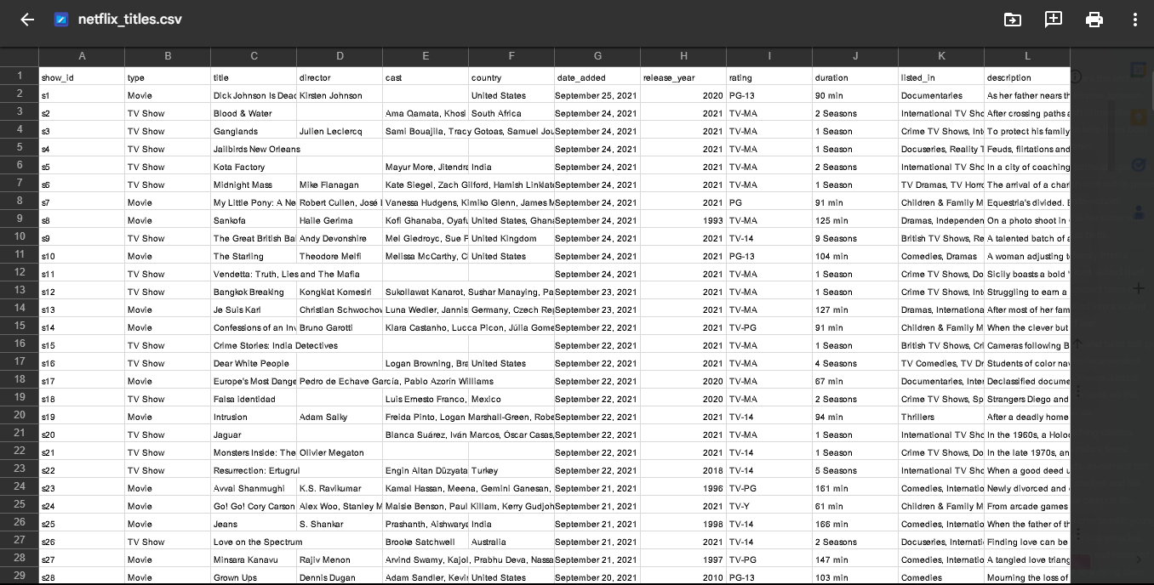
Dataset: Netflix dataset

Slide 7
Methods used:
Import Libraries :
NumPy
Pandas
Matplotlib
NumPy-Seaborn
Read the dataset
Use Panda data frame
Row and columns operation
Cleaning data
Data visualization

Slide 8
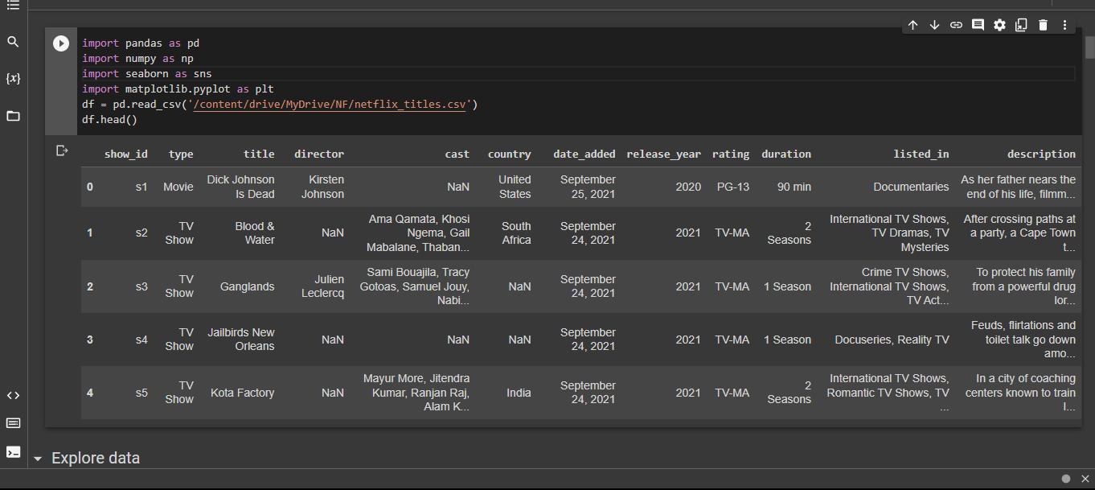
Result and it’s evaluation:

Slide 9
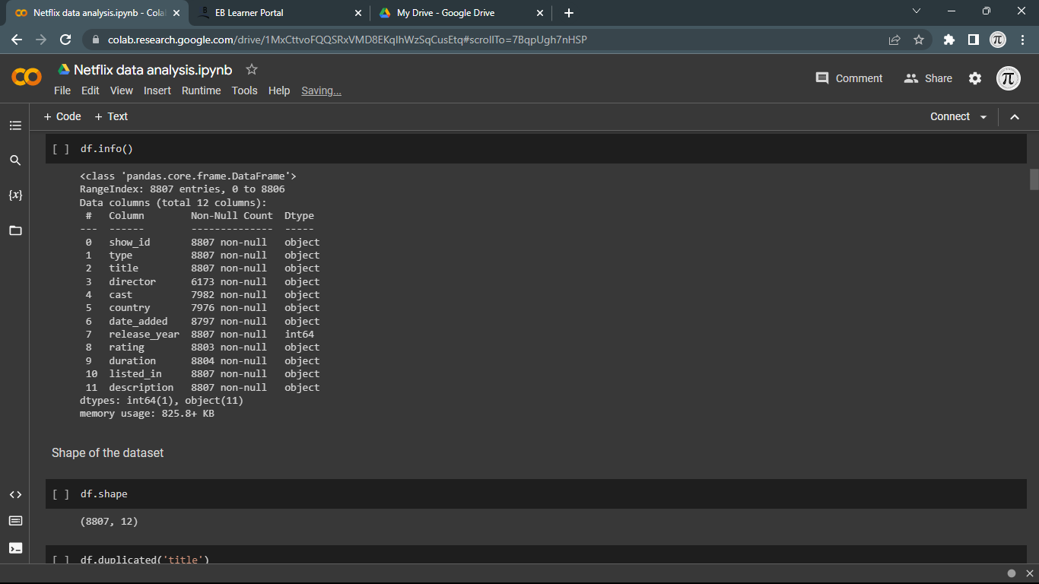

Slide 10
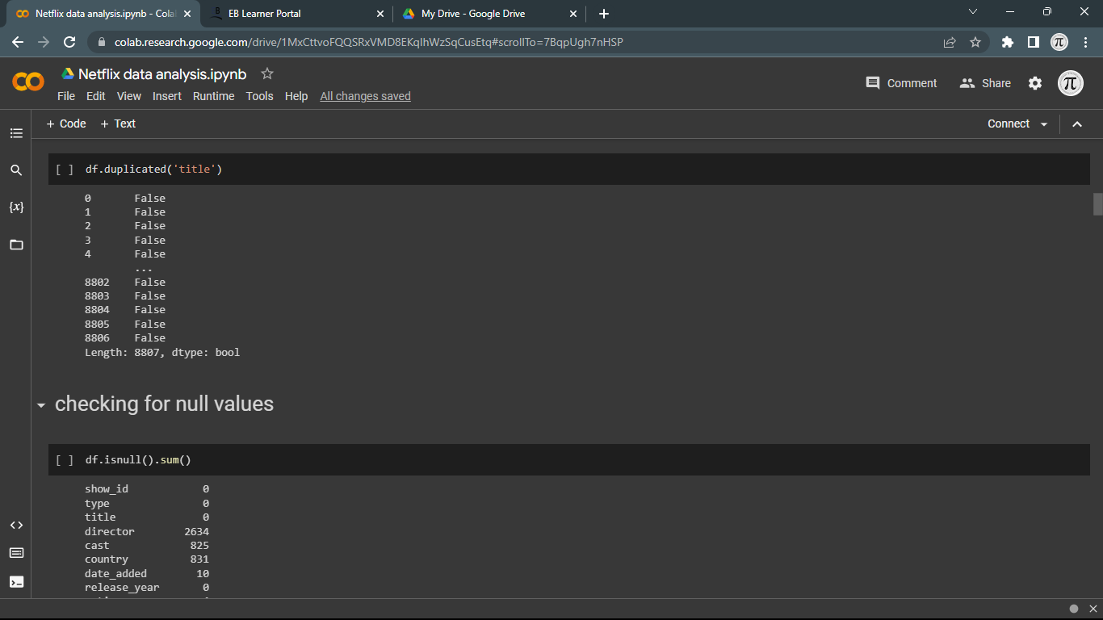

Slide 11
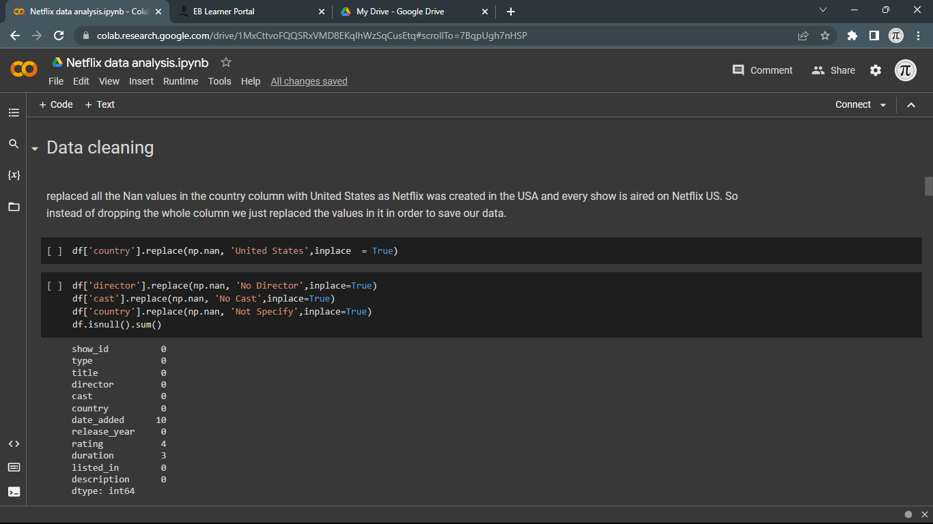

Slide 12
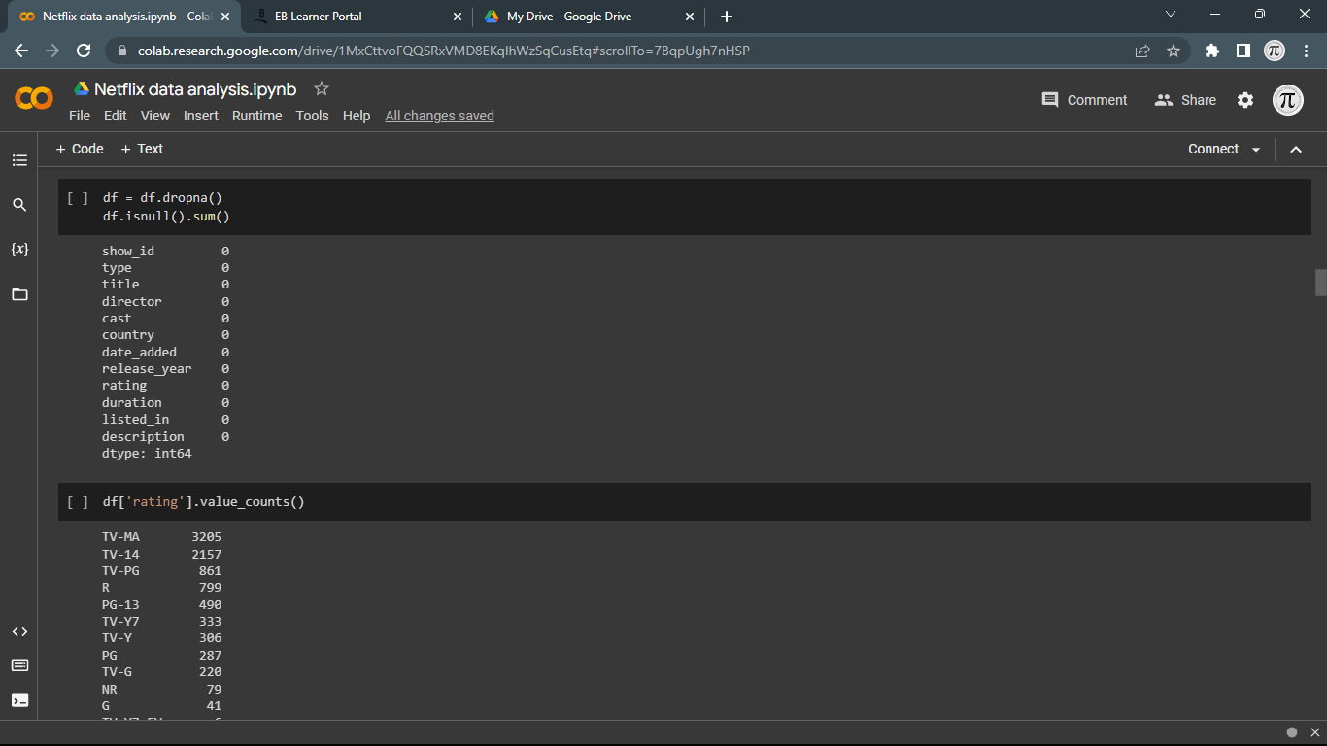

Slide 13
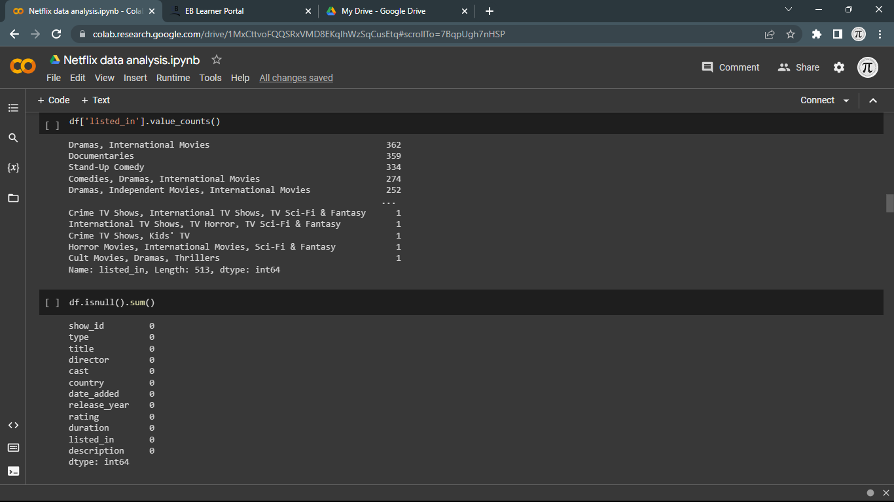

Slide 14
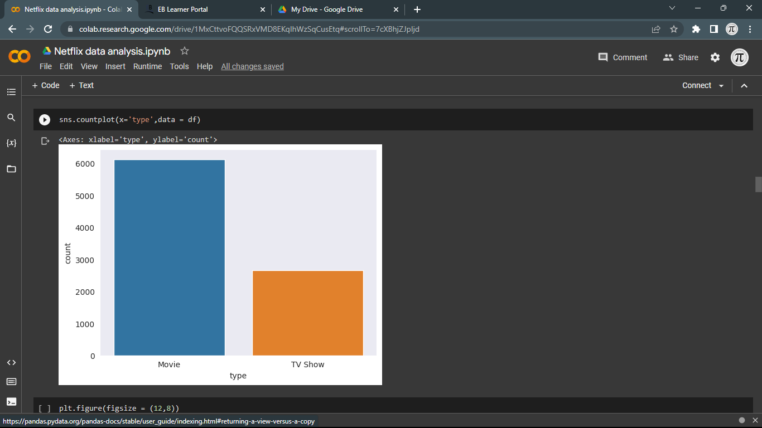

Slide 15
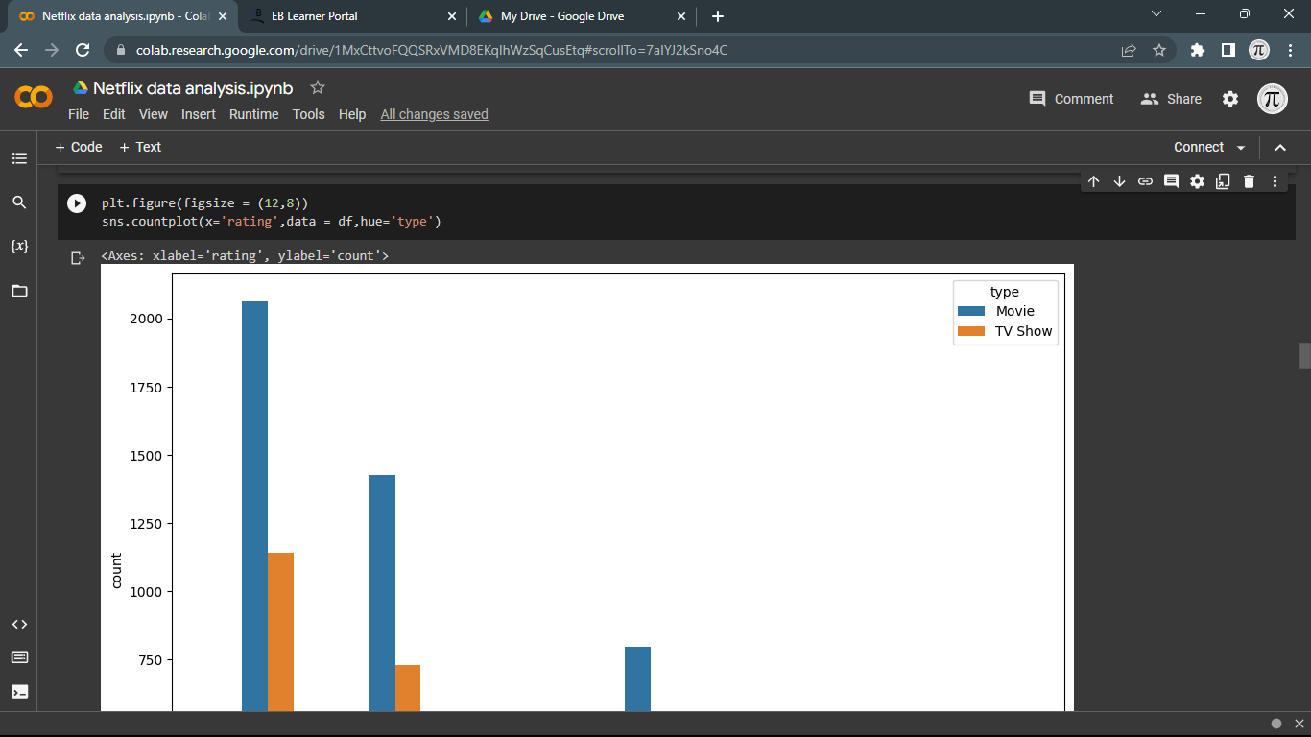

Slide 16
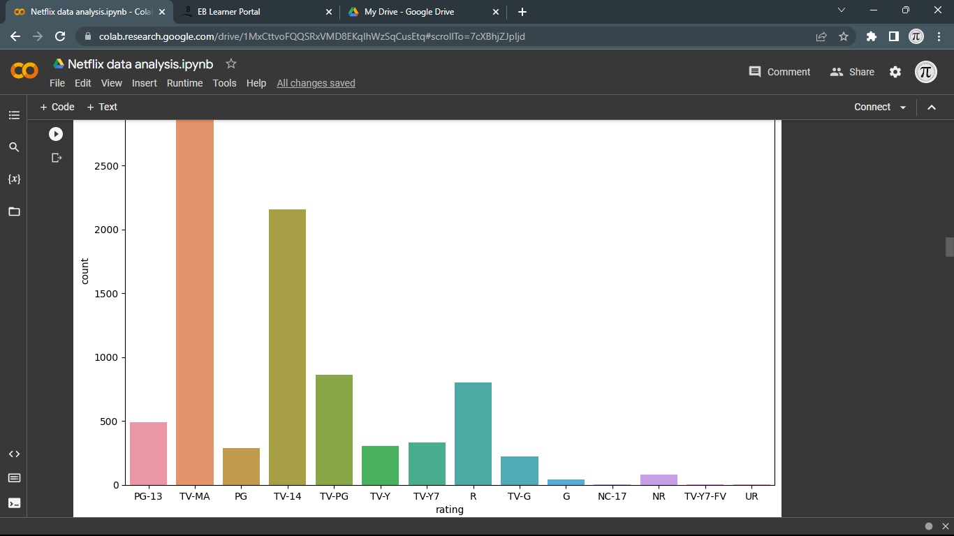

Slide 17
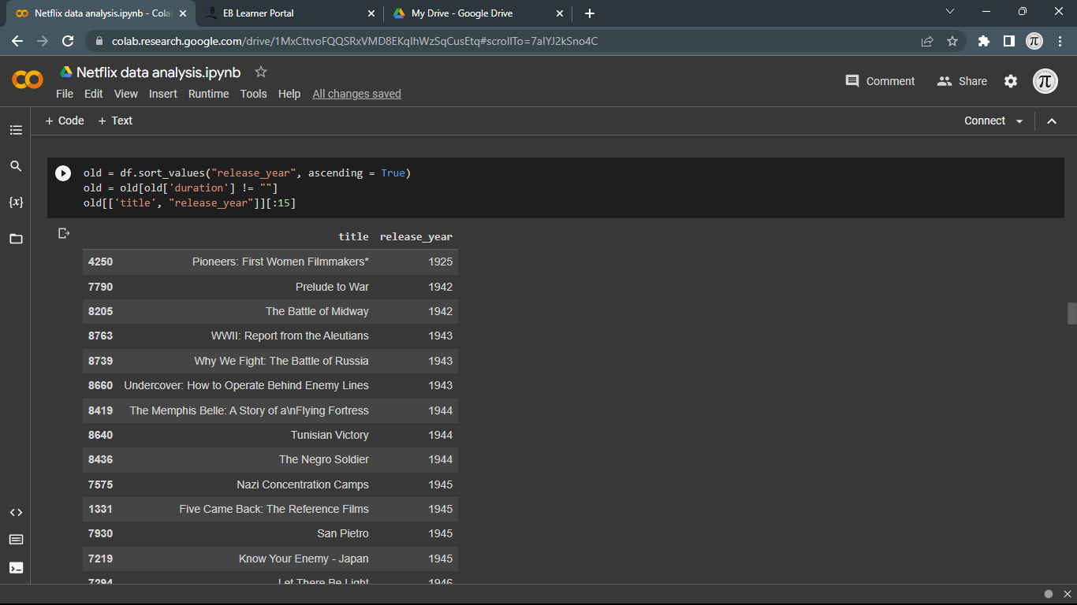

Slide 18
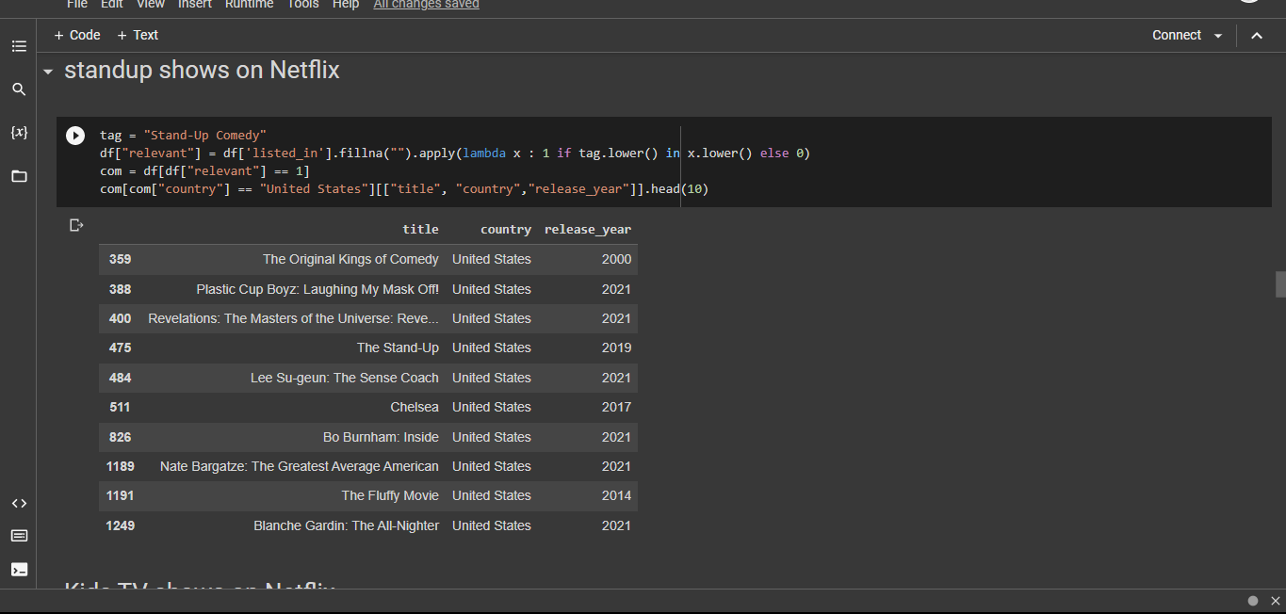

Slide 19
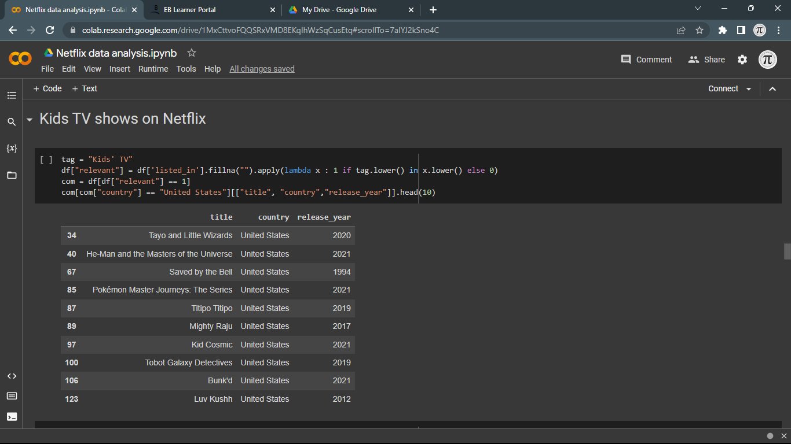

Slide 20
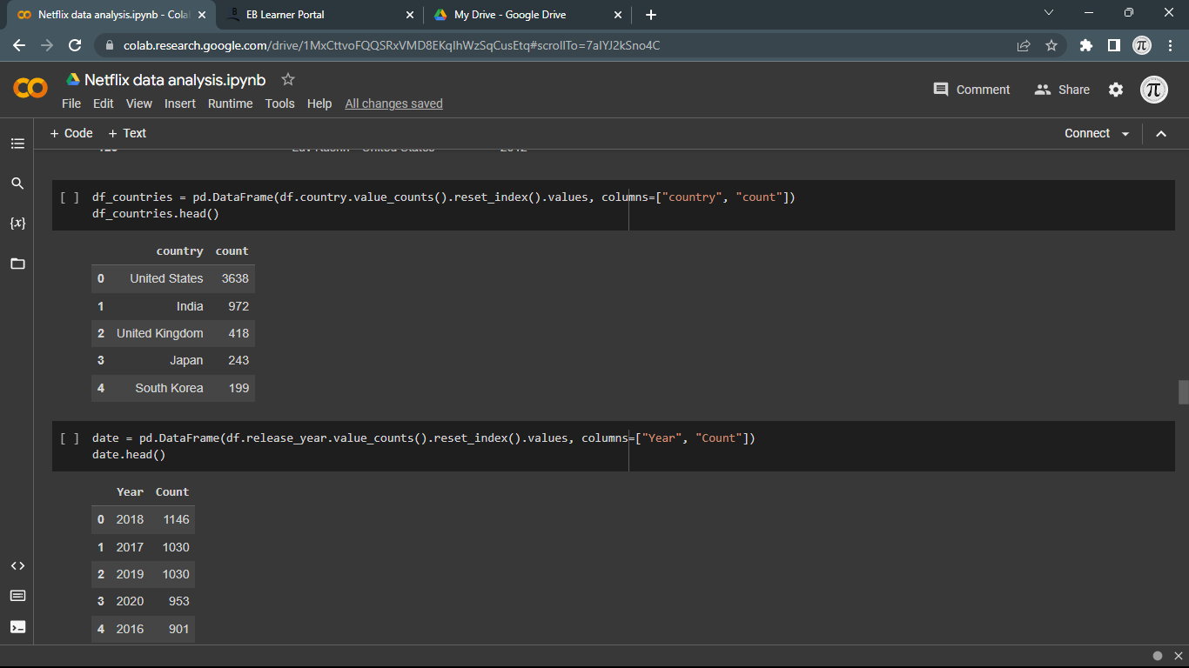

Slide 21
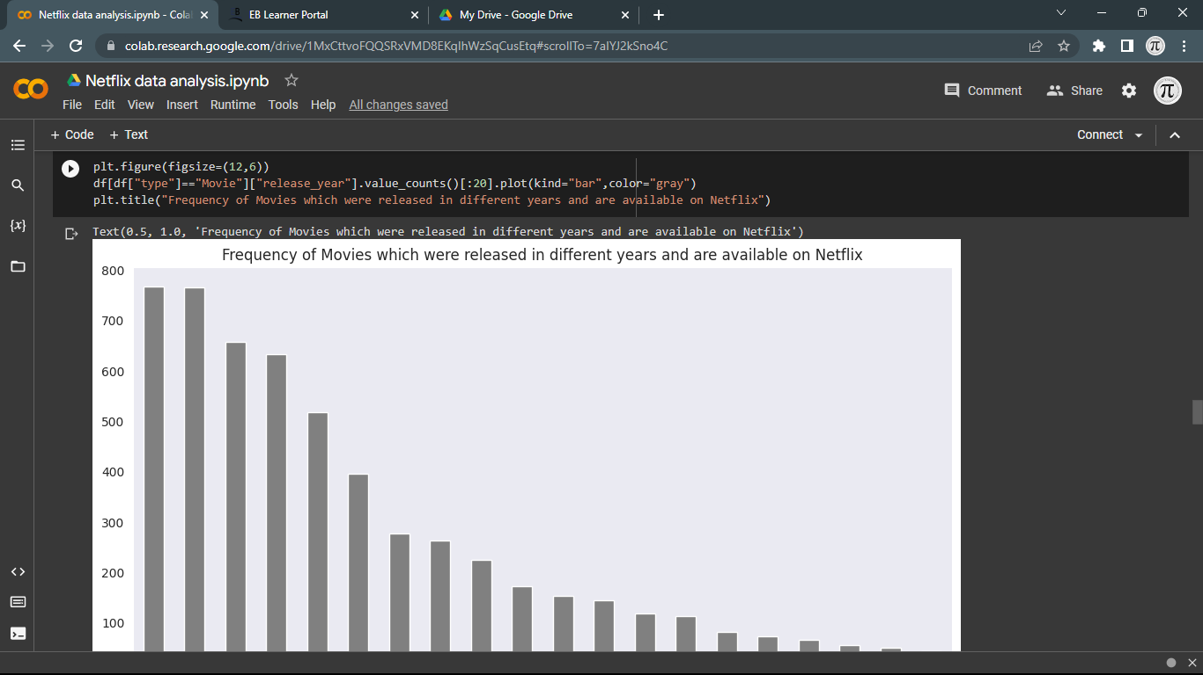

Slide 22
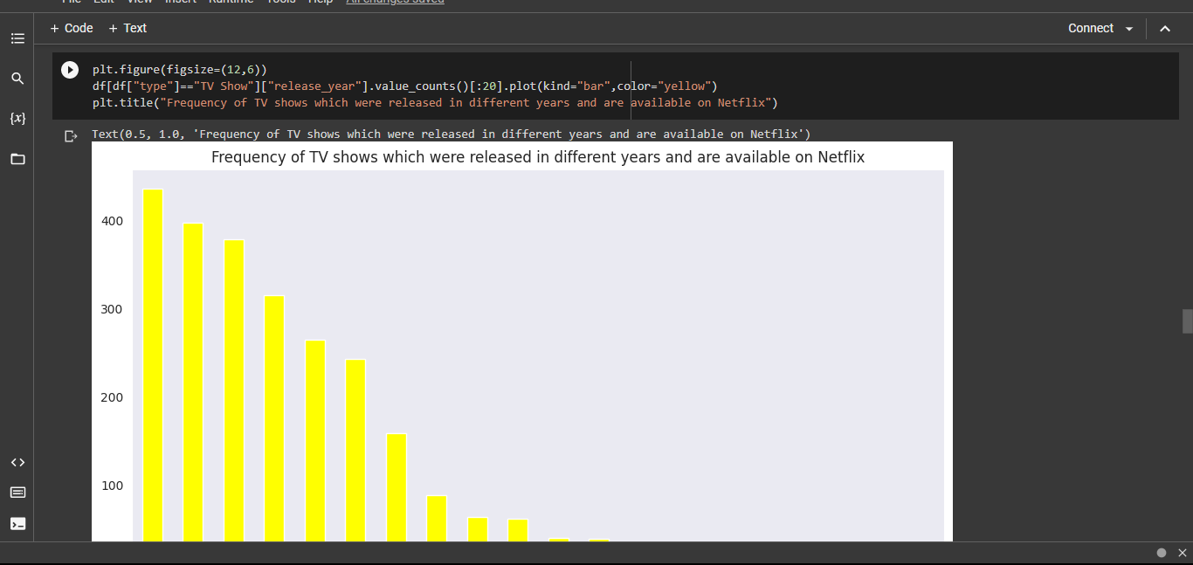

Slide 23
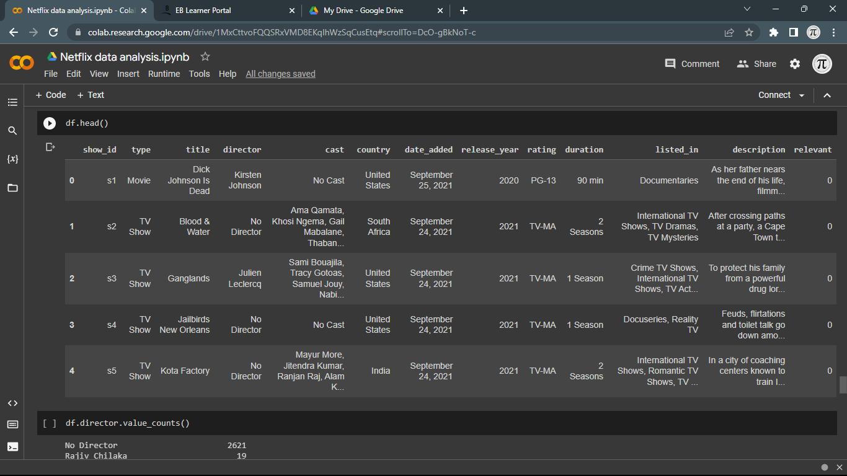

Slide 24
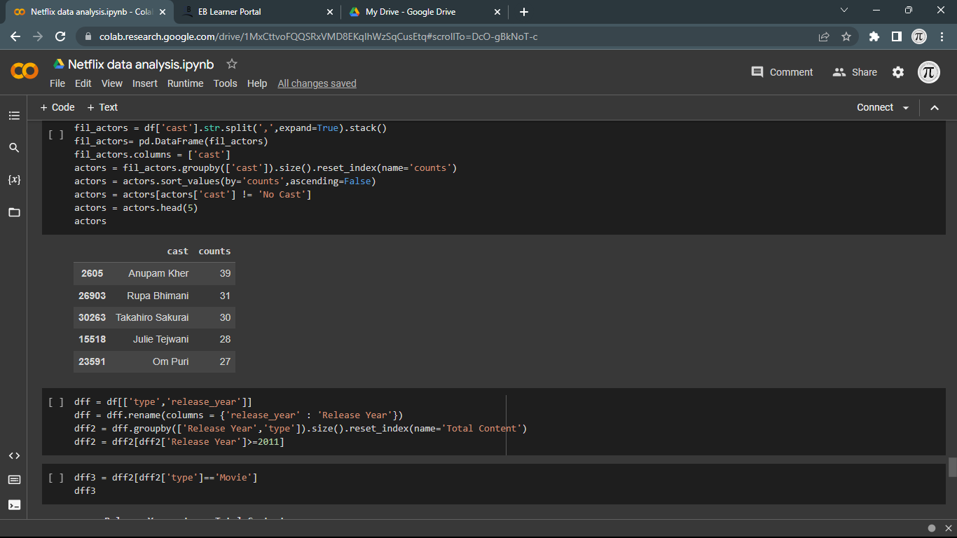

Slide 25
Conclusion:
It conclude that data visualization is to present complex data in a way that is easy to understand and interpret, allowing users to identify patterns, trends, and insights that may not be apparent from raw data. Data visualization can be used for various purposes, including exploratory data analysis, communication of insights to stakeholders, and decision-making.

Slide 26
Thank You…

